Slide 1
Harry Potter

Slide 2
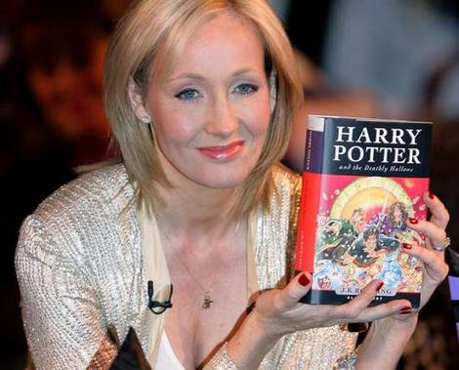
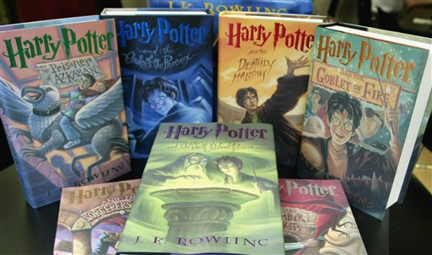
Joanne Rowling
Joanne Katheline Rowling (born 31 July 1965) is British, talented and modern writer and author of the Harry Potter fantasy series. She wanted to write one and only part of “Harry Potter” but she has written seven parts because people wanted a sequel.

Slide 3
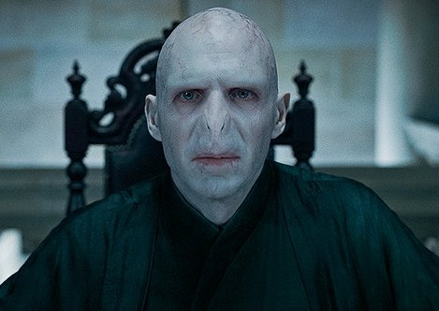
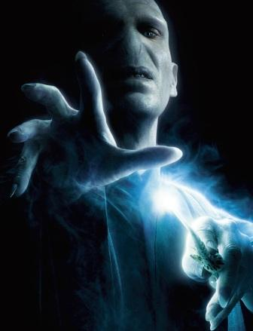
Lord Voldemort
Lord Voldemort (born Tom Marvolo Riddle) is a fictional character of Harry Potter series. "You-Know-Who" or "He-Who-Must-Not-Be-Named“ or “The Dark Wizard” is the main enemy of Harry Potter. His favorite curse is a Killing Curse.

Slide 4
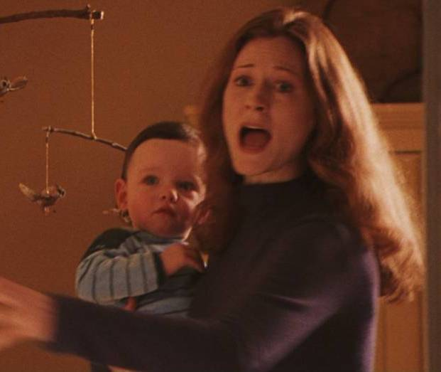
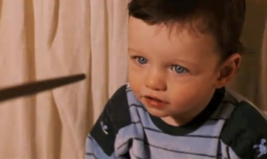
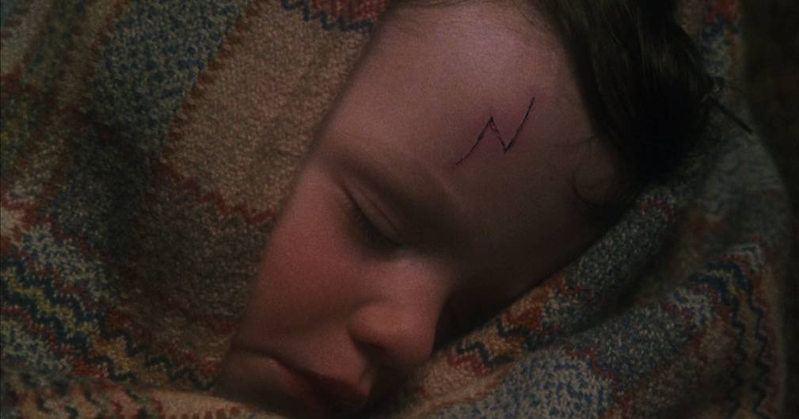
Mysterious scar
The Dark Lord has killed Harry's parents, James and Lily , but baby Harry has survived when Voldemort has tried to murder him with a Killing Curse, because his mother has sacrificed herself for him. Voldemort has disappeared, and Harry has a mysterious scar on his forehead.

Slide 5
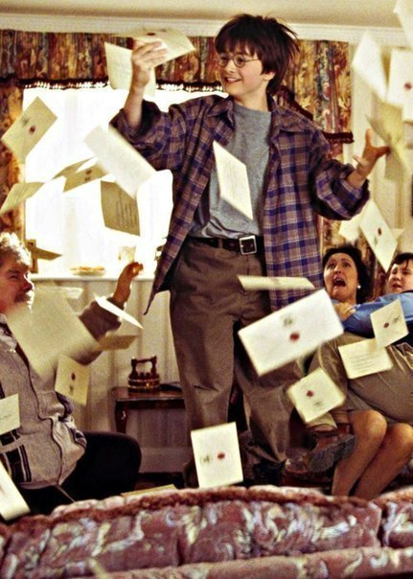
HOGWARTS
SCHOOL of WITCHCRAFT and WIZARDRY
When he is eleven Harry Potter has taken a letter from Hogwarts school of Witchcraft and Wizardry. And Harry Potter has become young wizard. In Hogwarts he has met friends, Ronald and Hermione.

Slide 6
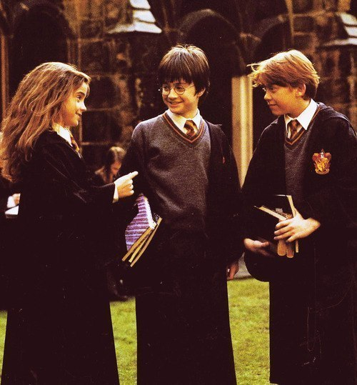
Ronald and Hermione
Hermione Granger was low and with lots of bushy brown hair.
Ronald Weasley was tall, thin, and with freckles and a long nose.

Slide 7
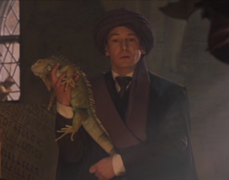
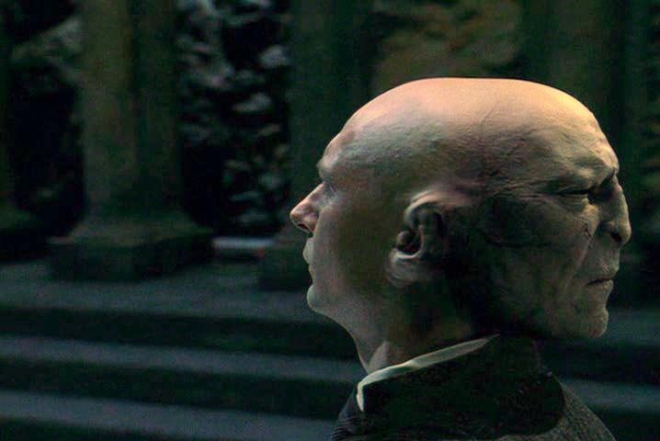
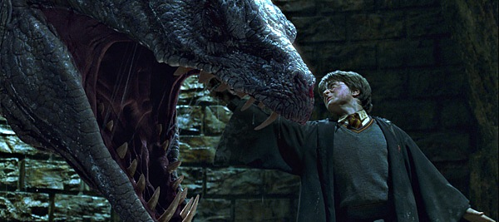
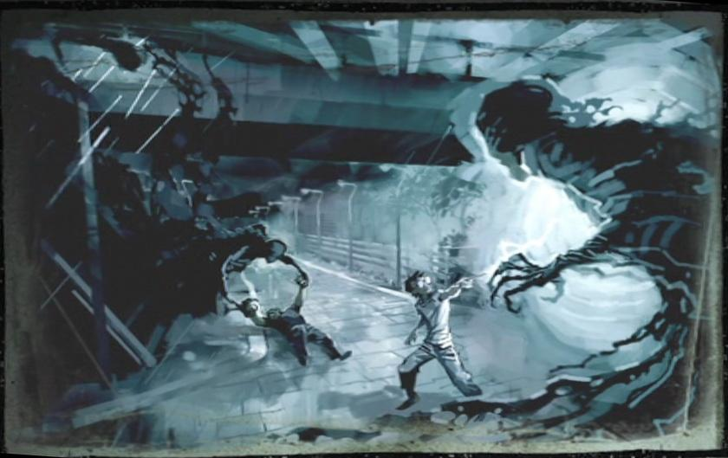
Powerful enemies
Professor Quirrell
or
The man with two faces
Vasilisk
Dementors

Slide 8
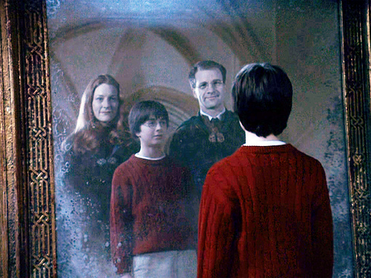
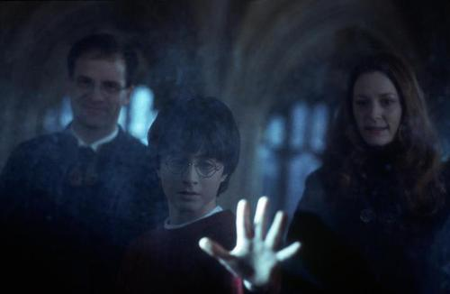
His Parents
His parents, James and Lily were killed by Lord Voldemort when Harry was a baby, but he has tried his parents to come back to make them alive.

Slide 9
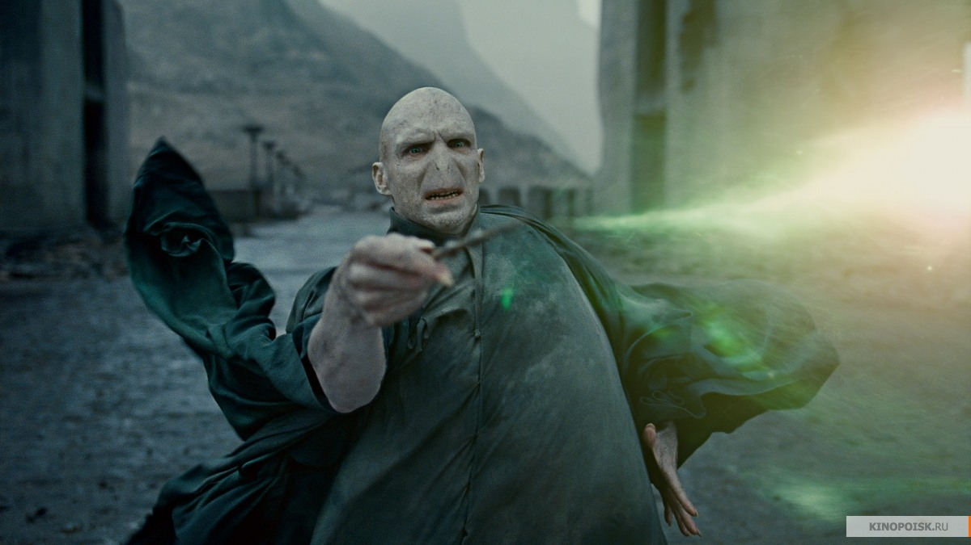
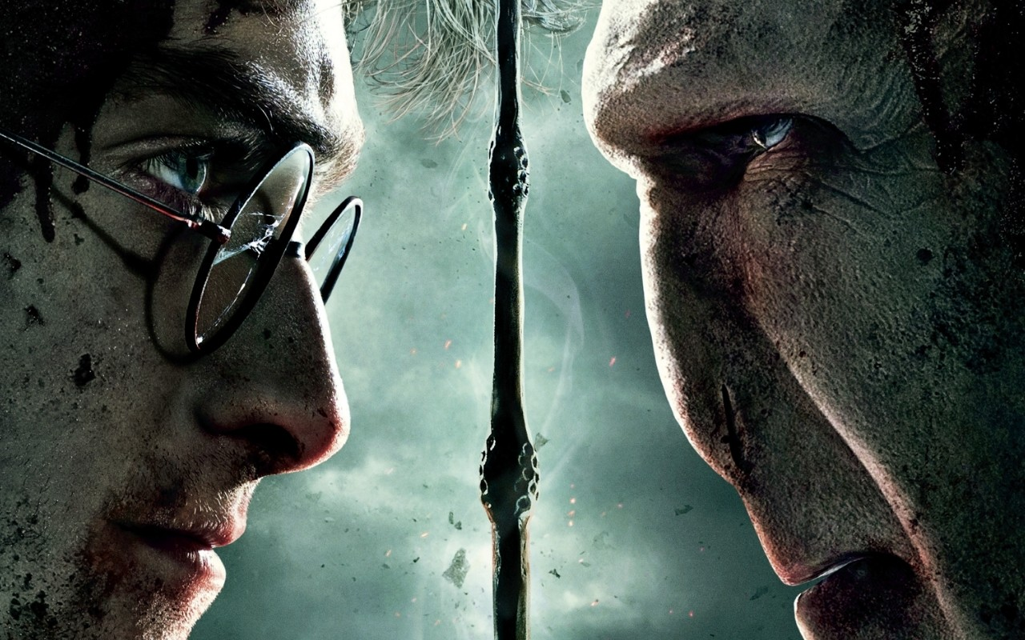
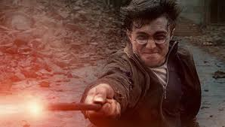
Harry Potter and the deathly hallows
In the last book “Harry Potter and the Deathly Hallows” Harry and his best friends will destroy seven parts of Voldemort’s soul, will meet face to face with Voldemort and will win.

Slide 10
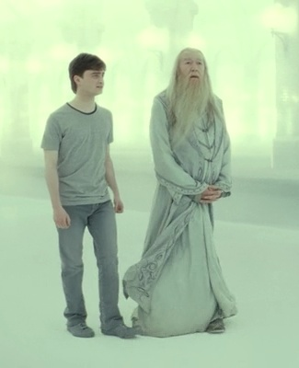
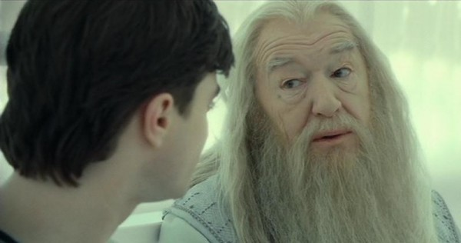
Dialogue between Harry and Professor Dumbledore in the last book.
Harry: “Is this real? Or has this been happening inside my head?”
Dumbledore : “Of course it is happening inside your head, but why on earth would that mean that is not real?”
Joanne Rowling said: “That dialogue is the key. I’ve been waiting seventeen years to use those lines. All this time I’ve worked to be able to write those two phrases; writing Harry entering the forest and Harry having that dialog.”

Slide 11
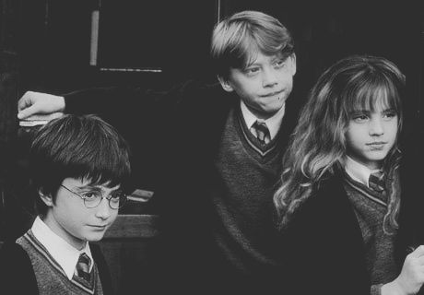
1090739 words
3363 pages
199 chapters
7 books
And the story that will stay in our hearts forever.

